Slide 1
Ordering negative integers
Comparing and ordering fractions and decimals (positive and negative)

Slide 2
how to use Oak lessons

Slide 3
I can compare negative integers using < and >.

Slide 4
The absolute value of a number is its distance from zero. E.g. 5 and (-5) are both 5 away from zero and so both have an absolute value of 5.

Slide 5

Ordering negative integers
Ordering negative integers in a context
Ordering negative integers

Slide 6
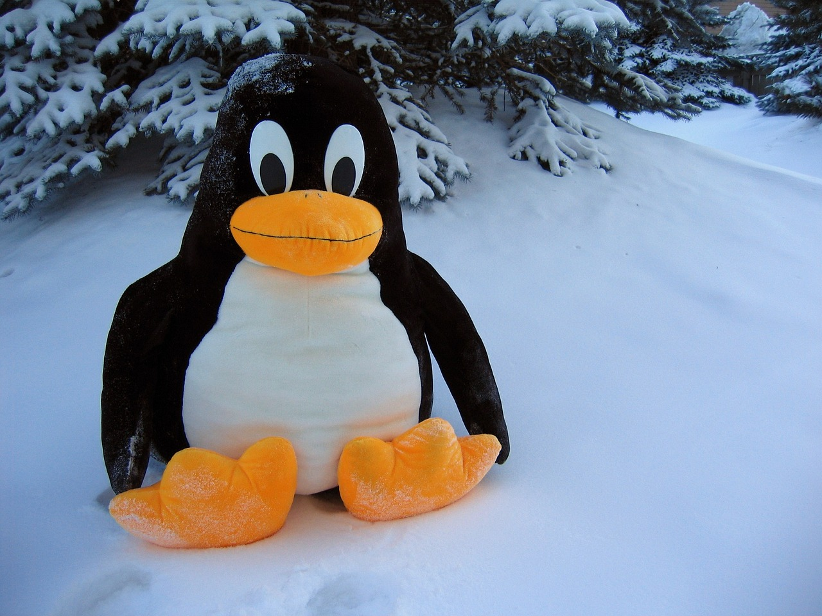
Ordering negative integers in a context
COOL CASH
In 2007 a lottery scratch card was withdrawn from sale!
The ‘Cool Cash’ games were released on a Monday but withdrawn from sale just 5 days later.
The game was withdrawn after some players failed to grasp whether or not they had won.

Slide 7
Ordering negative integers in a context
COOL CASH
One customer contacted Camelot and said:
"On one of my cards it said I had to find temperatures lower than −8. The numbers I uncovered were −6 and −7 so I thought I had won, and so did the woman in the shop. But when she scanned the card the machine said I hadn't.”
"I think Camelot are giving people the wrong impression - the card doesn't say to look for a colder or warmer temperature, it says to look for a higher or lower number. Six is a lower number than 8. Imagine how many people have been misled."
© Manchester Evening News

Slide 8
Ordering negative integers in a context
To qualify for a prize you had to reveal a temperature lower than the figure displayed, which was usually below zero.
(−6)℃
(−8)℃
(−7)℃
Why had they not won?
The greater the absolute value of a negative number the lower it is, as it is further away from zero.

Slide 9
Ordering negative integers in a context
To win you needed a number less than (−8)℃.
Sort the following numbers into winning temperatures and losing temperatures.
(−6)℃
(−10)℃
(−8.5)℃
(−3)℃
(−16)℃
Winning Temperatures
Losing Temperatures
(−10)℃
(−6)℃
(−8.5)℃
(−3)℃
(−16)℃

Slide 10

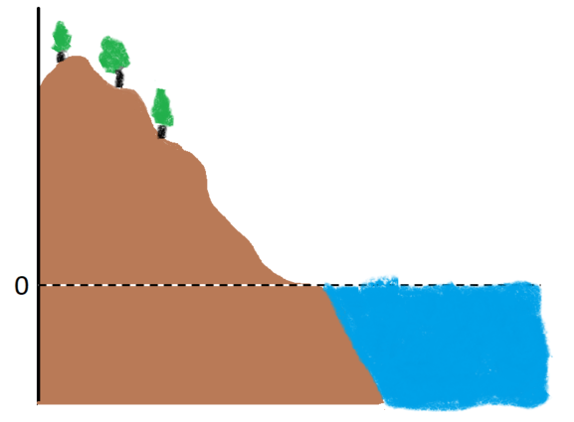
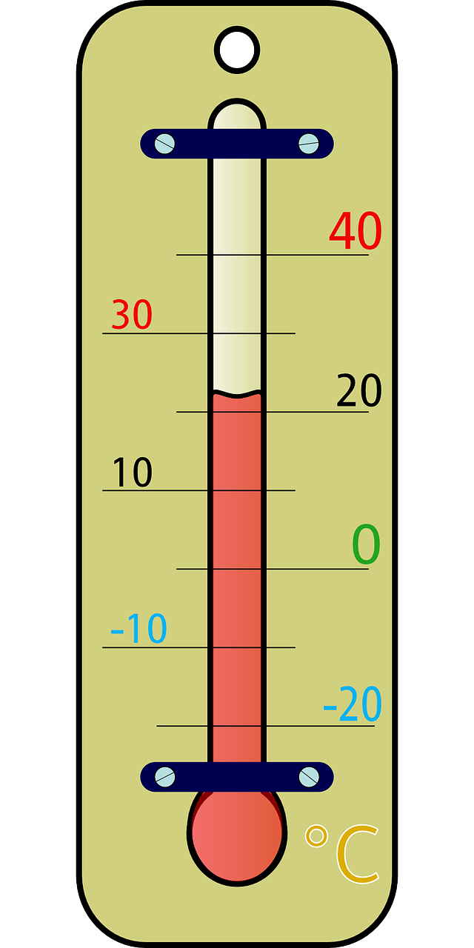
Ordering negative integers in a context
Here are some places that negative numbers can be seen in everyday life.
storeys in a building or a lift
temperature
sea level

Slide 11
Ordering negative integers in a context
Sea level is zero.
Anything
above
sea
level
will
be a
positive
.
number.
Anything
below
sea
level
will
be a
negative
.
number.
Write the following in order from the highest to the lowest.
fish (−3) m
seagull 200 m
sea level
octopus (−1800) m
kite 150 m
kite 150 m
fish (−3) m
seagull 200 m
shark (−1200) m
shark (−1200) m
octopus (−1800) m

Slide 12

Ordering negative integers in a context
List these temperatures in order from coldest to warmest.
(−6)℃ (−1)℃ (−8)℃ (−2)℃ (−12)℃
They are in the correct order, but from warmest to coldest
(−1)℃, (−2)℃, (−6)℃, (−8)℃, (−12)℃
(−12)℃, (−8)℃, (−6)℃, (−2)℃, (−1)℃
(−1)℃, (−2)℃, (−8)℃, (−6)℃, (−12)℃

Slide 13
Ordering negative integers in a context
Write the following temperatures from coldest to warmest.
(−10)℃ (−4)℃ (−8)℃ (−2)℃ (−5)℃
(−18)℃ (−22)℃ (−24)℃ (−16)℃ (−27)℃
(−32)℃ (−23)℃ (−43)℃ (−34)℃ (−48)℃
(−100)℃ (−104)℃ (−96)℃ (−88)℃ (−110)℃

Slide 14
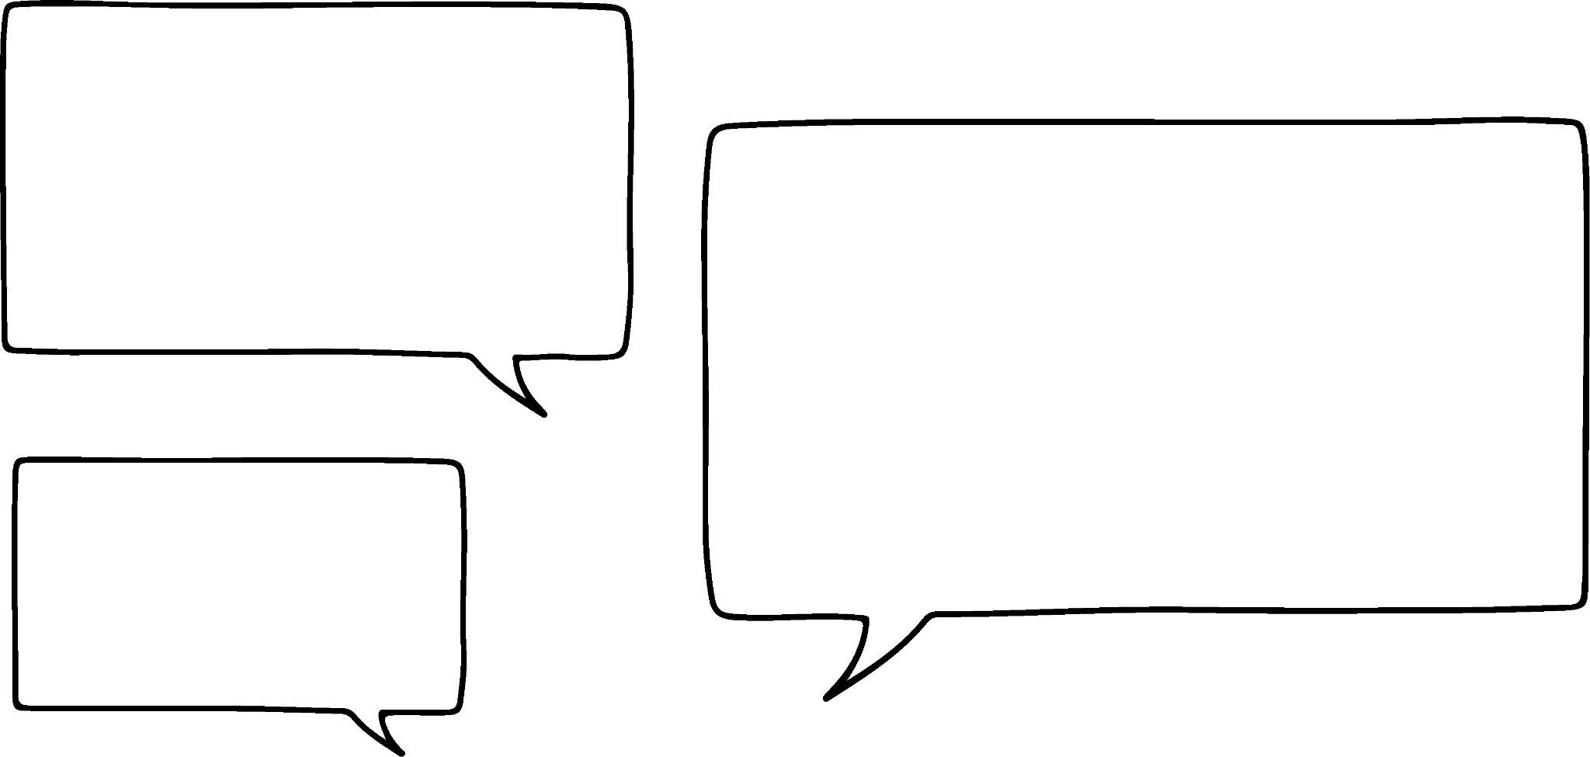




Ordering negative integers in a context
2) A quiz has ten questions.
Points are given as follows: 2 points for each correct answer
(−1) for a missed question
(−3) for an incorrect answer
I got 3 correct, 3 missed questions and 4 incorrect.
I got 5 correct, 1 missed question and 4 incorrect.
I got 4 correct, and 6 incorrect.
I got 3 correct, 5 missed questions and 2 incorrect.
Lucas
Laura
Jacob
Sofia
Work out their score and rank them from lowest to highest score.

Slide 15
Ordering negative integers in a context
3) A hotel has 10 floors below reception which is on the ground floor, floor 0.
There are bedrooms only on floors (−2), (−4), (−6) and (−7).
On the other floors are the following: staff room, gym, restaurant, maintenance office, basement and swimming pool.
Use the following clues to work out what is on each floor.
The swimming pool is 2 floors below the gym.
The staff room is between the basement and maintenance office.
The restaurant is higher up than the gym.
The maintenance office is 7 floors below the restaurant.
FLOOR

Slide 16
Ordering negative integers in a context
Write the following temperatures from coldest to warmest.
(−10)℃ (−4)℃ (−8)℃ (−2)℃ (−5)℃
(−18)℃ (−22)℃ (−24)℃ (−16)℃ (−27)℃
(−32)℃ (−23)℃ (−43)℃ (−34)℃ (−48)℃
(−100)℃ (−104)℃ (−96)℃ (−88)℃ (−110)℃
(−10)℃ (−8)℃ (−5)℃ (−4)℃ (−2)℃
(−27)℃ (−24)℃ (−22)℃ (−18)℃ (−16)℃
(−48)℃ (−43)℃ (−34)℃ (−32)℃ (−23)℃
(−110)℃ (−104)℃ (−100)℃ (−96)℃ (−88)℃

Slide 17
Ordering negative integers in a context
2) A quiz has ten questions.
Points are given as follows: 2 points for each correct answer
(−1) for a missed question
(−3) for an incorrect answer
I scored (−9)
I scored (−10)
I scored (−3)
I scored (−5)
Lucas
Laura
Jacob
Sofia
Work out their score and rank them from lowest to highest score.
Jacob (−10), Lucas (−9), Sofia (−5) and Laura (−3)

Slide 18
Ordering negative integers in a context
3) A hotel has 10 floors below reception which is on the ground floor, floor 0.
There are bedrooms only on floors (−2), (−4), (−6) and (−7).
On the other floors are the following: staff room, gym, restaurant, maintenance office, basement and swimming pool.
Use the following clues to work out what is on each floor.
The swimming pool is 2 floors below the gym.
The staff room is between the basement and maintenance office.
The restaurant is higher up than the gym.
The maintenance office is 7 floors below the restaurant.
FLOOR
0 | Reception
(−1) | Restaurant
(−2) | Bedrooms
(−3) | Gym
(−4) | Bedrooms
(−5) | Pool
(−6) | Bedrooms
(−7) | Bedrooms
(−8) | Office
(−9) | Staff room
(−10) | Basement

Slide 19
Ordering negative integers
Ordering negative integers in a context
Ordering negative integers

Slide 20
Ordering negative integers
It can be useful to consider negative integers on a number line.
Absolute values increase
Absolute values increase
0

Slide 21
Ordering negative integers
Which is greater?
(−46)
(−50)
>
Absolute value is 46
Absolute value is 50
The integer with the highest absolute value is the least because they are both negative but (−50) is further away from zero.

Slide 22
Ordering negative integers
Which is greater?
(−185)
(−158)
<
(−6875)
(−6785)
<
(−35 024)
(−35 042)
>

Slide 23


Ordering negative integers
The integer with the greatest absolute value is the smallest.
No, it is not always true.
Is this always true?
Jun
Aisha
Try to think of an example when the statement is not true.
E.g. If you were comparing 7 and (−2)
The absolute value of 7 is 7 and the absolute value of (−2) is 2. 7 has the higher absolute value but (−2) is less than 7 as we are comparing a negative integer with a positive integer.
The statement is only true if you are comparing just negative integers.

Slide 24
Ordering negative integers
What number are the arrows pointing to?
(−7)
(−1)
a
b
(−3)
0

Slide 25
Ordering negative integers
What number are the arrows pointing to?
(−12)
a
(−5)
(−6)
b
(−4)
(−10)
0
5 parts represents 10
10 ÷ 5 = 2
Each part represents 2

Slide 26
Ordering negative integers
What number is the arrow pointing to in each of these?
(−4)
a)
b)
c)
0
2
(−12)
0
2
(−7)
0
2

Slide 27
Ordering negative integers
Aisha and Jun are trying to write these integers in ascending order.
(−3)
(−10)
(−7)
(−8)
(−14)
Jun’s list: (−14), (−10), (−7), (−8), (−3)
You are right Aisha. I’ve got the (−7) and (−8) the wrong way around.
I think one of them is in the wrong place.
Aisha
Jun

Slide 28
Ordering negative integers
Which of the following are in ascending order?
(−55), (−59), (−53), (−52)
The (−59) is in the wrong place.
The (−24) is in the wrong place.
(−38), (−24), (−25), (−18), (−3)
They are in descending order.
(−6), (−51), (−62), (−97), (−101)
(−11), (−9), (−5), (−3), (−1)

Slide 29
Ordering negative integers
Write the following sets of integers in ascending order.
(−6), (−9), (−5), (−8), (−3)
(−18), (−19), (−25), (−28), (−13)
(−89), (−91), (−88), (−99), (−19)
(−256), (−119), (−112), (−265), (−312)
(−6123), (−6321), (−6213), (−6231), (−6312), (−6132)

Slide 30
Ordering negative integers
2) Put the following integers into the grid.
(−7)
(−2)
(−10)
(−5)
(−15)
(−8)
(−6)
(−1)
(−20)
(−9)
(−3)
(−12)
(−18)
(−9)
(−10)
(−5)
(−8)
(−2)
(−4)
(−5)
Least
Greatest
Least
Greatest

Slide 31
Ordering negative integers
Write the following sets of integers in ascending order.
(−6), (−9), (−5), (−8), (−3)
(−9), (−8), (−6), (−5), (−3)
(−18), (−19), (−25), (−28), (−13)
(−28), (−25), (−19), (−18), (−13)
(−89), (−91), (−88), (−99), (−19)
(−99), (−91), (−89), (−88), (−19)
(−256), (−119), (−112), (−265), (−312)
(−312), (−265), (−256), (−119), (−112)
(−6123), (−6321), (−6213), (−6231), (−6312), (−6132)
(−6321), (−6312), (−6231), (−6213), (−6132), (−6123)

Slide 32
Ordering negative integers
2) Put the following integers into the grid.
(−7)
(−2)
(−10)
(−5)
(−15)
(−8)
(−6)
(−1)
(−20)
(−9)
(−3)
(−12)
(−18)
(−9)
(−10)
(−5)
(−8)
(−2)
(−4)
(−5)
Least
Greatest
Least
(−20) | (−15) | (−9) | (−6) | (−5)
(−18) | (−10) | (−8) | (−5) | (−4)
(−12) | (−9) | (−7) | (−3) | (−2)
(−10) | (−8) | (−5) | (−2) | (−1)
Greatest

Slide 33
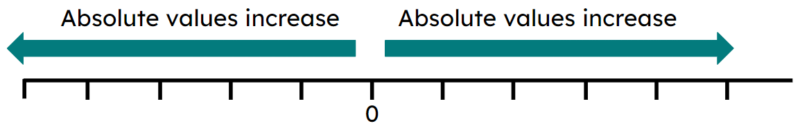
Ordering negative integers
It can be useful to think of temperature when dealing with negative numbers.
E.g. −7 is colder than −2 so you write −7 < −2
A number line can be useful to order or compare negative integers.

Slide 34

© Oak National Academy 2023.
Produced in partnership with Mathematics in Education and Industry.
Licensed on the Open Government Licence v3.0, except where otherwise stated. See Oak terms and conditions.

